Slide 1
Synthesis: hands-on exercise

Slide 2

A workflow for 16S analysis
1
Collect sample
(e.g. skin swab)
2
Total DNA
extraction
3
Amplify variable region
of 16S rRNA gene
V4
Sequence 16S
rRNA genes
Processing, QC, and assembly
of reads
Generate a representative sequence for each species and assign taxonomy
4
5
6
Read 1
Read 2
7
relative abundance plot
diversity plot
Who? How much?
abundance
diversity
healthy
diseased
healthy
diseased
Notes:
http://learn.genetics.utah.edu/content/microbiome/intro/
https://www.theatlantic.com/technology/archive/2012/11/what-dna-actually-looks-like/265713/

Slide 3
A microbiome module by design
Conceptual goals for students
• why do we sequence the 16S gene?
• how do we decide which 16S sequences belong to which organism?
• what can relative abundance and diversity plots tell us?
• develop hypothesis and test it
Data science goals for students
• file manipulation from the command line
• writing and executing ”for loops”
• running commands in terminal
• data visualization in R
• writing R notebooks

Slide 4
A microbiome module by design
Teaching implementation goals
• allows for individual student curiosity & open-endedness
• real-world medical relevance
• easily sourced raw data
• do not have to wait for code to run
• avoid painful coding “typos”
• avoid version/compatibility issues

Slide 5
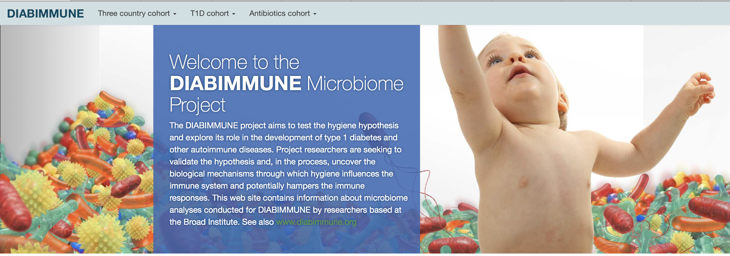
The exercise: an overview
“What is the role of the microbiome and the “hygiene hypothesis” in the development of type 1 diabetes and other auto-immune diseases?”
https://pubs.broadinstitute.org/diabimmune

Slide 6
The exercise: an overview
“The goal of this cohort is to compare microbiome in infants who have developed type 1 diabetes (T1D) or serum autoantibodies (markers predicting the onset of T1D) with healthy controls in the same area.”

Slide 7
The exercise: an overview
Command line
review
metaseqR
phyloseq
usearch
relative abundance table
Diab-
immune
OTU count table
linux
FLASh
usearch
usearch
source raw 16S reads
prepare reads for analysis
combine paired reads
identify unique AND n>1,
sequences
alpha diversity
plot
cluster OTUs
assign taxonomy
beta diversity plot
rdp
classifier
Notes:
NOTES:
Tab to complete
Have everyone watch me first and THEN try on machine

Slide 8
The exercise: an overview
Command line
review
metaseqR
phyloseq
usearch
relative abundance table
Diab-
immune
OTU count table
linux
FLASh
usearch
usearch
source raw 16S reads
prepare reads for analysis
combine paired reads
identify unique AND n>1,
sequences
alpha diversity
plot
cluster OTUs
assign taxonomy
• choose files
• download files
• uncompress files
beta diversity plot
rdp
classifier

Slide 9
The exercise: an overview
Command line
review
metaseqR
phyloseq
usearch
relative abundance table
Diab-
immune
OTU count table
linux
FLASh
usearch
usearch
source raw 16S reads
prepare reads for analysis
combine paired reads
identify unique AND n>1,
sequences
alpha diversity
plot
cluster OTUs
assign taxonomy
• rename files case/control
• create symbolic links
• take a peak at the data
beta diversity plot
rdp
classifier

Slide 10
The exercise: an overview
Command line
review
metaseqR
phyloseq
usearch
relative abundance table
Diab-
immune
OTU count table
linux
FLASh
usearch
usearch
source raw 16S reads
prepare reads for analysis
combine paired reads
identify unique AND n>1,
sequences
alpha diversity
plot
cluster OTUs
assign taxonomy
• pair reads with for loop
• convert fastq to fasta
beta diversity plot
rdp
classifier

Slide 11
The exercise: an overview
Command line
review
metaseqR
phyloseq
usearch
relative abundance table
Diab-
immune
OTU count table
linux
FLASh
usearch
usearch
source raw 16S reads
prepare reads for analysis
combine paired reads
identify unique AND n>1,
sequences
alpha diversity
plot
cluster OTUs
assign taxonomy
• pool all samples
• remove duplicates
• remove singletons
beta diversity plot
rdp
classifier

Slide 12
The exercise: an overview
Command line
review
metaseqR
phyloseq
usearch
relative abundance table
Diab-
immune
OTU count table
linux
FLASh
usearch
usearch
source raw 16S reads
prepare reads for analysis
combine paired reads
identify unique AND n>1,
sequences
alpha diversity
plot
cluster OTUs
assign taxonomy
• cluster pooled seqs > OTUs
• relabel OTUs for ease
beta diversity plot
rdp
classifier

Slide 13
The exercise: an overview
Command line
review
metaseqR
phyloseq
• match sample reads to OTUs
• count how many times each OTU got a match
usearch
relative abundance table
Diab-
immune
OTU count table
linux
FLASh
usearch
usearch
source raw 16S reads
prepare reads for analysis
combine paired reads
identify unique AND n>1,
sequences
alpha diversity
plot
cluster OTUs
assign taxonomy
• assign taxonomy for each OTU
beta diversity plot
rdp
classifier

Slide 14
The exercise: an overview
Command line
review
metaseqR
phyloseq
usearch
relative abundance table
Diab-
immune
OTU count table
linux
FLASh
usearch
usearch
source raw 16S reads
prepare reads for analysis
combine paired reads
identify unique AND n>1,
sequences
alpha diversity
plot
cluster OTUs
assign taxonomy
beta diversity plot
rdp
classifier

Slide 15
Revisiting our goals
Conceptual goals for students
• why do we sequence the 16S gene?
• how do we decide which 16S sequences belong to which organism?
• what can relative abundance and diversity plots tell us?
• develop hypothesis and test it
Data science goals for students
• file manipulation from the command line
• writing and executing ”for loops”
• running commands in terminal
• data visualization in R
• writing R notebooks

Slide 16
Revisiting our goals
Teaching implementation goals
• allows for individual student curiosity & open-endedness
• real-world medical relevance
• easily sourced raw data
• do not have to wait for code to run
• avoid painful coding “typos”
• avoid version/compatibility issues

